Slide 1
Fundamentals of Machine Learning

Slide 2
Outline
SVD Decomposition
Computation of Eigen value and Eigen vectors

Slide 3
Singular value decomposition (SVD)

Slide 4
Singular value decomposition(SVD)
Solve matrix system of equation Ax=b ,for non-square matrix A ( particularly used in regression model)
Extract most important features
Can be used basis for PCA for dimensionality reduction
Used in google’s page rank algorithm
Used in recommendation system
Many more applications

Slide 5
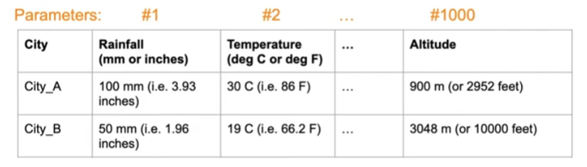

Eigen Values and Eigen vectors
Why use Eigenvalues & Eigenvectors?
In machine learning, Eigen vectors can be used to reduce dimensionality.
Can we extract a smaller set of variables (features) to train the models and do the prediction while ensuring that most of the information contained in the original variables is retained/maintained.

Slide 6
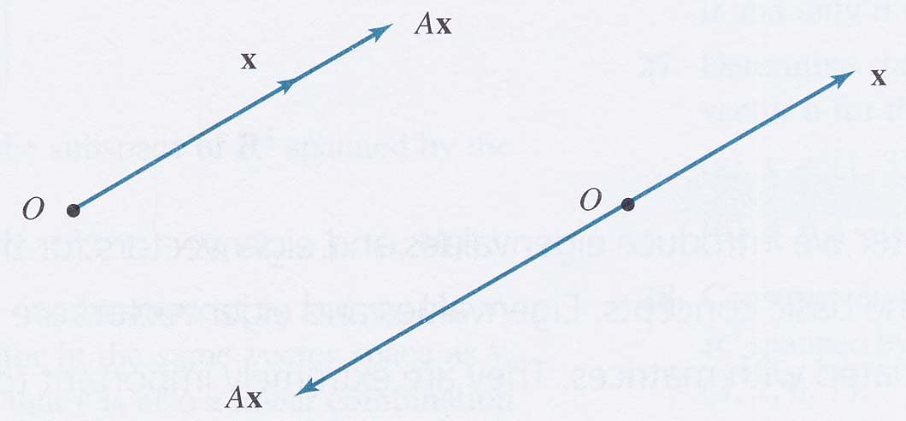
Eigenvalues and Eigenvectors
Definition
Let A be an n × n matrix. A scalar λ is called an eigenvalue of A if there exists a nonzero vector x in R^{n} such that
Ax = λx.
The vector x is called an eigenvector corresponding to λ.
Source : https://slideplayer.com/slide/12368523/

Slide 7
Computation of Eigenvalues and Eigenvectors
Let A be an n × n matrix with eigenvalue λ and corresponding eigenvector x. Thus Ax = λx. This equation may be written
Ax – λx = 0
given
(A – λI_{n})x = 0
Solving the equation |A – λI_{n}| = 0 for λ leads to all the eigenvalues of A.
The equation |A – λI_{n}| = 0 is called the characteristic equation of A.

Slide 8
Example 1
Solution
Let us first derive the characteristic polynomial of A.
We get
We now solve the characteristic equation of A.
The eigenvalues of A are 2 and –1.
The corresponding eigenvectors are found by using these values of λ in the equation(A – λI₂)x = 0. There are many eigenvectors corresponding to each eigenvalue.

Slide 9
For λ = 2
We solve the equation (A – 2I₂)x = 0 for x.
The matrix (A – 2I₂) is obtained by subtracting 2 from the diagonal elements of A. We get
This leads to the system of equations
giving x₁ = –x₂. The solutions to this system of equations are x₁ = –r, x₂ = r, where r is a scalar. Thus the eigenvectors of A corresponding to λ = 2 are nonzero vectors of the form

Slide 10
For λ = –1
We solve the equation (A + 1I₂)x = 0 for x.
The matrix (A + 1I₂) is obtained by adding 1 to the diagonal elements of A. We get
This leads to the system of equations
Thus x₁ = –2x₂. The solutions to this system of equations are x₁ = –2s and x₂ = s, where s is a scalar. Thus the eigenvectors of A corresponding to λ = –1 are nonzero vectors of the form

Slide 11
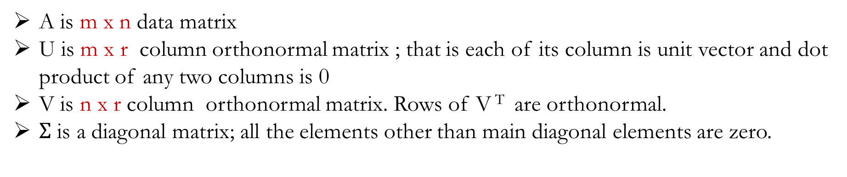
Computation of SVD
The matrix A is decomposed into
$A=UΣ$V^{T} , where U and V are orthogonal matrices and $Σ is a diagonal matrix$
Left singular
matrx
Right singular matrix
Singular values
A is m x n data matrix
U is m x r column orthonormal matrix ; that is each of its column is unit vector and dot product of any two columns is 0
V is n x r column orthonormal matrix. Rows of V ^{T} are orthonormal.
$Σ$ is a diagonal matrix; all the elements other than main diagonal elements are zero.

Slide 12

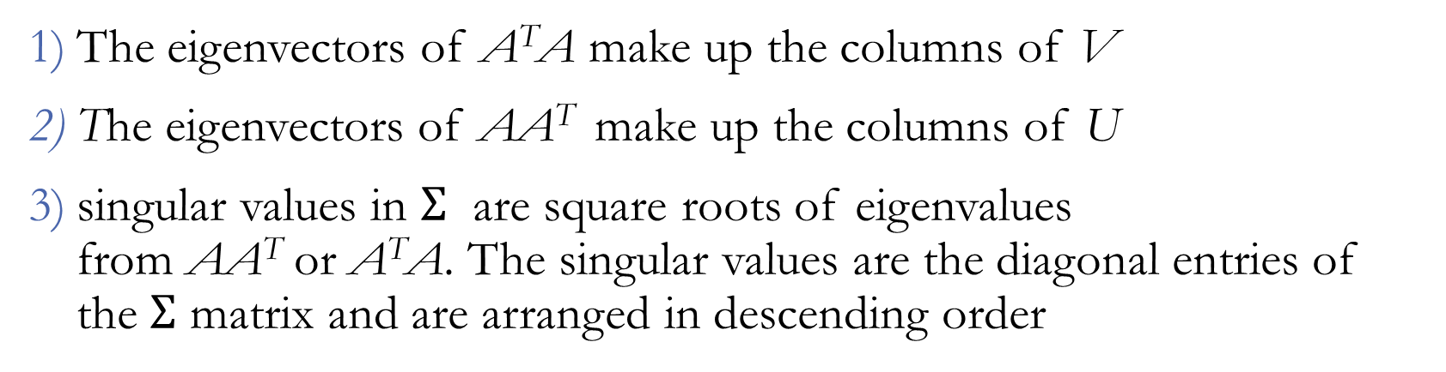
Computation of U ,V and $Σ$
The eigenvectors of A^{T}A make up the columns of V
The eigenvectors of AA^{T} make up the columns of U
singular values in $Σ$ are square roots of eigenvalues from AA^{T} or A^{T}A.The singular values are the diagonal entries of the $Σ$ matrix and are arranged in descending order

Slide 13
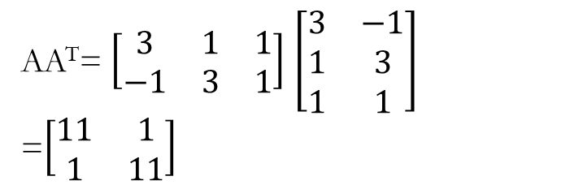

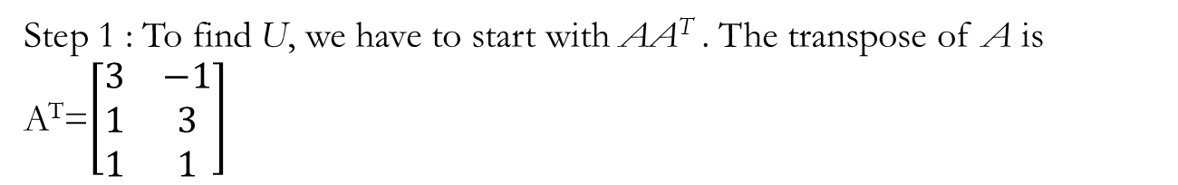

Example
Compute SVD decomposition of Matrix
A=$\left[\begin{matrix}3 & 1 & 1 \\ −1 & 3 & 1\end{matrix}\right]$
$A=UΣ$V^{T} , where U and V are orthonormal vectors and $Σ is singular matrix$
$Computation of U$
Step 1 : To find U, we have to start with AA^{T}. The transpose of A is
A^{T}=$\left[\begin{matrix}3 & −1 \\ 1 & 3 \\ 1 & 1\end{matrix}\right]$
Step 2 : Find eigen values and corresponding eigen vectors of AA^{T} .
AA^{T}=$\left[\begin{matrix}3 & 1 & 1 \\ −1 & 3 & 1\end{matrix}\right]$$\left[\begin{matrix}3 & −1 \\ 1 & 3 \\ 1 & 1\end{matrix}\right]$ =$\left[\begin{matrix}11 & 1 \\ 1 & 11\end{matrix}\right]$
Source :https://datajobs.com/data-science-repo/SVD-Tutorial-[Kirk-Baker].pdf

Slide 14
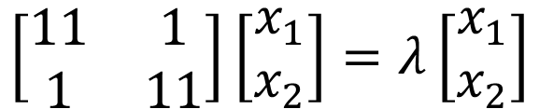
Step 2 : Find eigen values and corresponding eigen vectors of AA^{T} .
eigenvectors are defined by the equation A⃗v = λ⃗v, and applying this to AA^{T} gives :
$$\left[\begin{matrix}11 & 1 \\ 1 & 11\end{matrix}\right]\left[\begin{matrix}x_{1} \\ x_{2}\end{matrix}\right]=λ\left[\begin{matrix}x_{1} \\ x_{2}\end{matrix}\right]$$
rewrite this as the set of equations
11x1 + x2 = λx1
x1 + 11x2 = λx2
Rearranging this equation to
(11 − λ)x1 + x2 = 0
x1 + (11 − λ)x2 = 0

Slide 15
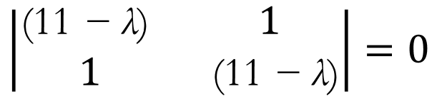
Solve for λ by setting the determinant of the coefficient matrix to zero,
$$\left|\begin{matrix}\text{(11 }\text{− }\text{λ}\text{) } & 1 \\ 1 & \text{ (11 }\text{− }\text{λ}\text{)}\end{matrix}\right|=0$$
(11 − λ)(11 − λ) − 1 · 1 = 0
(λ − 10)(λ − 12) = 0
λ = 10, λ = 12
Substitute λ back in to the original equations to compute eigenvectors.
For λ = 10
(11 − 10)x1 + x2 = 0
x1 = −x2, which is true for lots of values, so we'll pick x1 = 1 and x2 = −1
Thus, we have the eigenvector [1,−1] corresponding to the eigenvalue λ = 10.

Slide 16
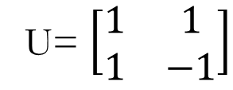
For λ = 12
(11 − 12)x1 + x2 = 0
x1 = x2
Choose x1 = 1 and x2 = 1. for λ = 12 we have the
eigenvector [1, 1].
The eigen vector corresponding to the largest eigen value will be the first column in the matrix and the second largest value in the second column.
U= $\left[\begin{matrix}1 & 1 \\ 1 & −1\end{matrix}\right]$
The Matrix U has to be orthogonal.
A matrix U is orthogonal, if U.U^{T}=I
Step 3: convert this matrix into an orthogonal matrix by applying the Gram-Schmidt orthonormalization process

Slide 17
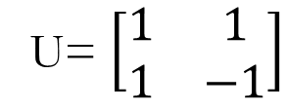
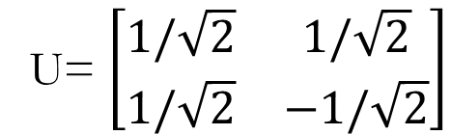
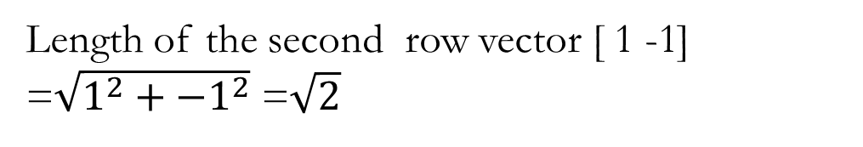
Step 3: convert this matrix into an orthogonal matrix by applying the Gram-Schmidt orthonormalization process to the column vectors
U= $\left[\begin{matrix}1 & 1 \\ 1 & −1\end{matrix}\right]$
Divide each component in the row vector by its length, hence
Length of the first row vector [ 1 1] =$\sqrt{1^{2}+1^{2}}$ =$\sqrt{2}$
Length of the second row vector [ 1 -1] =$\sqrt{1^{2}+{−1}^{2}}$ =$\sqrt{2}$
U= $\left[\begin{matrix}1/\sqrt{2} & 1/\sqrt{2} \\ 1/\sqrt{2} & −1/\sqrt{2}\end{matrix}\right]$

Slide 18
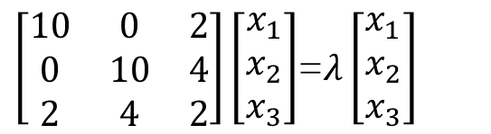
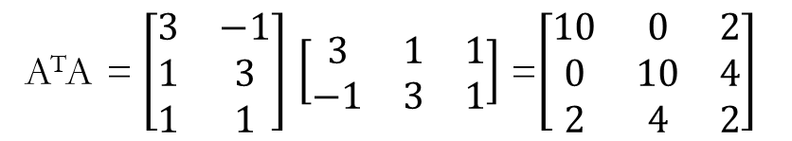
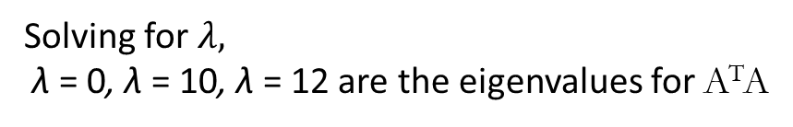
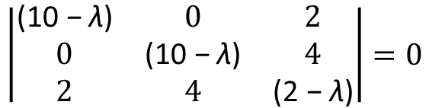
The calculation of V is similar. V is based on A^{T}A, so we have
A^{T}A=$\left[\begin{matrix}3 & −1 \\ 1 & 3 \\ 1 & 1\end{matrix}\right]$$\left[\begin{matrix}3 & 1 & 1 \\ −1 & 3 & 1\end{matrix}\right]$=$\left[\begin{matrix}10 & 0 & 2 \\ 0 & 10 & 4 \\ 2 & 4 & 2\end{matrix}\right]$
which rewritten as
(10 − λ)x1 + 2x3 = 0
(10 − λ)x2 + 4x3 = 0
2x1 + 4x2 + (2 − λ)x3 = 0
Find the eigenvalues of A^{T}A by
$\left[\begin{matrix}10 & 0 & 2 \\ 0 & 10 & 4 \\ 2 & 4 & 2\end{matrix}\right]\left[\begin{matrix}x_{1} \\ x_{2} \\ x_{3}\end{matrix}\right]$=$λ\left[\begin{matrix}x_{1} \\ x_{2} \\ x_{3}\end{matrix}\right]$
which are solved by setting
$$\left|\begin{matrix}\text{(10 }\text{− }\text{λ}\text{)} & 0 & 2 \\ 0 & \text{(10 }\text{− }\text{λ}\text{)} & 4 \\ 2 & 4 & \text{(}\text{2} \text{− }\text{λ}\text{)}\end{matrix}\right|=0$$
which represents the system of equations
10x1 + 2x3 = λx1
10x2 + 4x3 = λx2
2x1 + 4x2 + 2x3 = λx2
λ(λ − 10)(λ − 12) = 0,
Solving for $λ,$
λ = 0, λ = 10, λ = 12 are the eigenvalues for A^{T}A

Slide 19
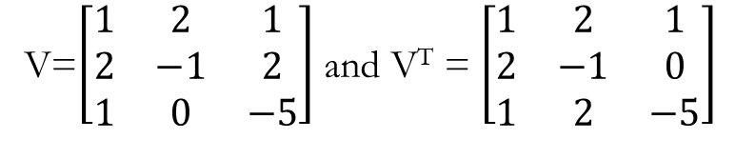
Substituting λ back into the original equations to find corresponding eigenvectors
For λ = 0
10x1 + 2x3 = 0
x3 = −5
10x1 − 20 = 0
x2 = 2
2x1 + 8 − 10 = 0
x1 = 1
So for λ = 0, ⃗v3 = [1, 2,−5].
for λ = 12
(10 − 12)x1 + 2x3 = −2x1 + 2x3 = 0
x1 = 1, x3 = 1
(10 − 12)x2 + 4x3 = −2x2 + 4x3 = 0
x2 = 2x3
x2 = 2
So for λ = 12, ⃗v1 = [1, 2, 1].
Order ⃗v1, ⃗v2, and ⃗v3 as column vectors in a matrix
according to the size of the eigenvalues
For λ = 10 we have
(10 − 10)x1 + 2x3 = 2x3 = 0
x3 = 0
2x1 + 4x2 = 0
x1 = −2x2
x1 = 2, x2 = −1
So for λ = 10, ⃗v2 = [2,−1, 0].
V=$\left[\begin{matrix}1 & 2 & 1 \\ 2 & −1 & 2 \\ 1 & 0 & −5\end{matrix}\right]$ and V^{T} = $\left[\begin{matrix}1 & 2 & 1 \\ 2 & −1 & 0 \\ 1 & 2 & −5\end{matrix}\right]$

Slide 20
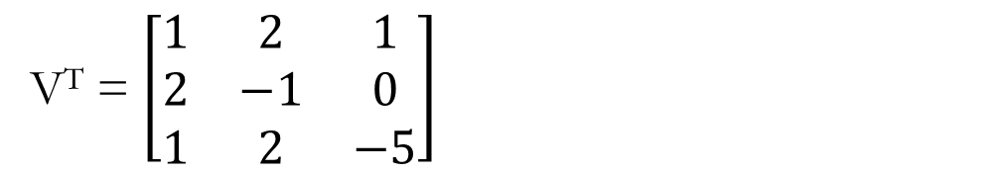
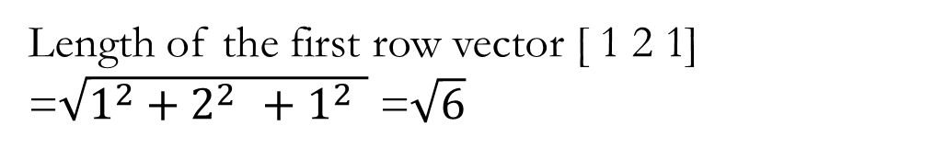
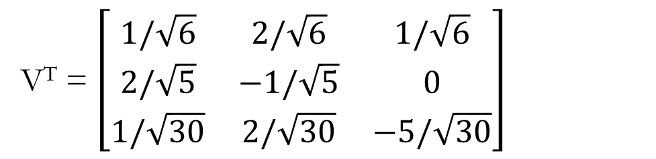
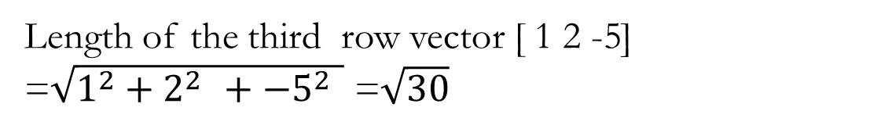
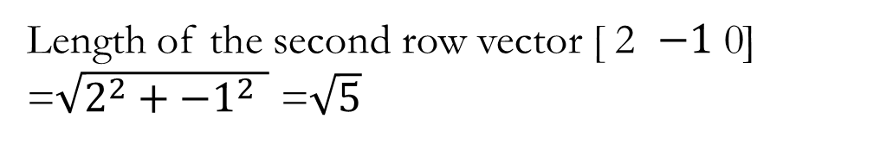
convert this matrix V^{T} into an orthogonal matrix by applying the Gram-Schmidt orthonormalization process
V^{T} = $\left[\begin{matrix}1 & 2 & 1 \\ 2 & −1 & 0 \\ 1 & 2 & −5\end{matrix}\right]$
Length of the first row vector [ 1 2 1] =$\sqrt{1^{2}+2^{2 }+1^{2 }}$ =$\sqrt{6}$
Length of the second row vector [ 2 $−1$ 0] =$\sqrt{2^{2}+{−1}^{2 }}$ =$\sqrt{5}$
Length of the third row vector [ 1 2 -5] =$\sqrt{1^{2}+2^{2 }+{−5}^{2 }}$ =$\sqrt{30}$
Divide each component in the row vector by its length, hence
V^{T} = $\left[\begin{matrix}1/\sqrt{6} & 2/\sqrt{6} & 1/\sqrt{6} \\ 2/\sqrt{5} & −1/\sqrt{5} & 0 \\ 1/\sqrt{30} & 2/\sqrt{30} & −5/\sqrt{30}\end{matrix}\right]$

Slide 21
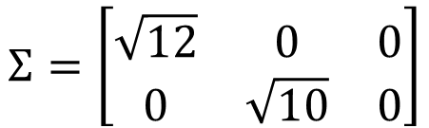
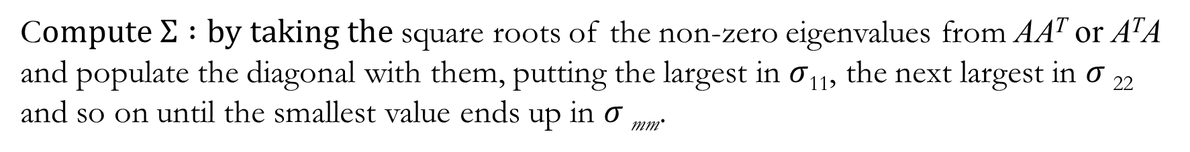
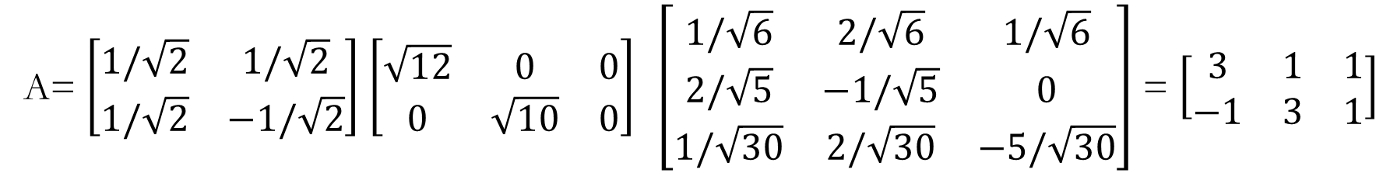

C$ompute Σ :by taking the$square roots of the non-zero eigenvalues from AA^{T} or A^{T}A and populate the diagonal with them, putting the largest in $σ$₁₁, the next largest in $σ$₂₂ and so on until the smallest value ends up in $σ$_{mm}.
$$Σ=\left[\begin{matrix}\sqrt{12} & 0 & 0 \\ 0 & \sqrt{10} & 0\end{matrix}\right]$$
Now we have$A=UΣ$V^{T} as
A= $\left[\begin{matrix}1/\sqrt{2} & 1/\sqrt{2} \\ 1/\sqrt{2} & −1/\sqrt{2}\end{matrix}\right]$$\left[\begin{matrix}\sqrt{12} & 0 & 0 \\ 0 & \sqrt{10} & 0\end{matrix}\right] \left[\begin{matrix}1/\sqrt{6} & 2/\sqrt{6} & 1/\sqrt{6} \\ 2/\sqrt{5} & −1/\sqrt{5} & 0 \\ 1/\sqrt{30} & 2/\sqrt{30} & −5/\sqrt{30}\end{matrix}\right]$ = $\left[\begin{matrix}3 & 1 & 1 \\ −1 & 3 & 1\end{matrix}\right]$

Slide 22
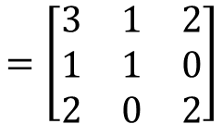

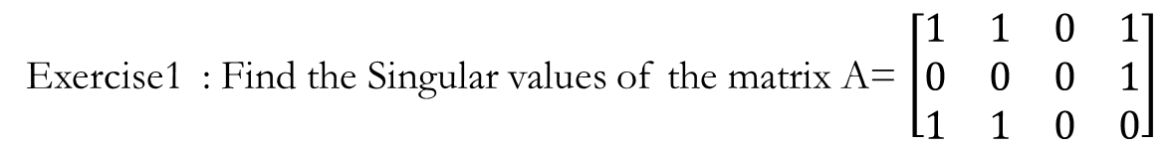

Exercise1 : Find the Singular values of the matrix A= $\left[\begin{matrix}1 & 1 & 0 & 1 \\ 0 & 0 & 0 & 1 \\ 1 & 1 & 0 & 0\end{matrix}\right]$
Solution :
Step 1:Compute AA^{T} (This is the smaller of the two symmetric matrices associated with A.)
$$=\left[\begin{matrix}3 & 1 & 2 \\ 1 & 1 & 0 \\ 2 & 0 & 2\end{matrix}\right]$$
AA^{T}
Step 2: Find the eigenvalues of this matrix. The characteristic polynomial ${\text{λ}}^{3 }$-6${\text{λ}}^{2 }$+6
$The solution gives three eigen values : {\text{λ}}^{ }$=3$+\sqrt{3 }$,${\text{λ}}^{ }$=3$−\sqrt{3 }$ and ${\text{λ}}^{ }$=0
For the singular values of A, we now take the square roots of the eigenvalues of AA^{T}
$σ_{1 }$=$\sqrt{3+\sqrt{3}}$
and
$σ_{2 }$=$\sqrt{3−\sqrt{3}}$

Slide 23
Exercise 2: Find the SVD of the matrix A= $\left[\begin{matrix}1 & 0 & 1 & 0 \\ 0 & 1 & 0 & 1\end{matrix}\right]$

